Slide 1
Agenda 10/18
Projectors Primer
Studio Time / Experiment with Projectors

Slide 2
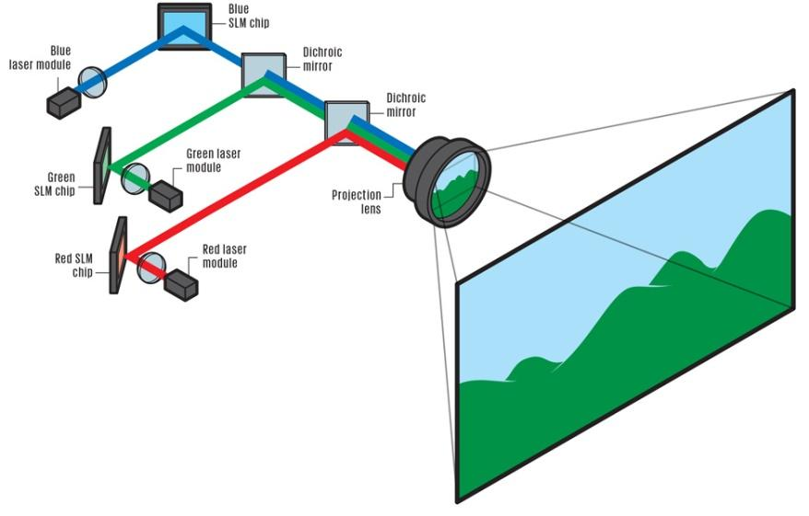
Projector Lens

Slide 3
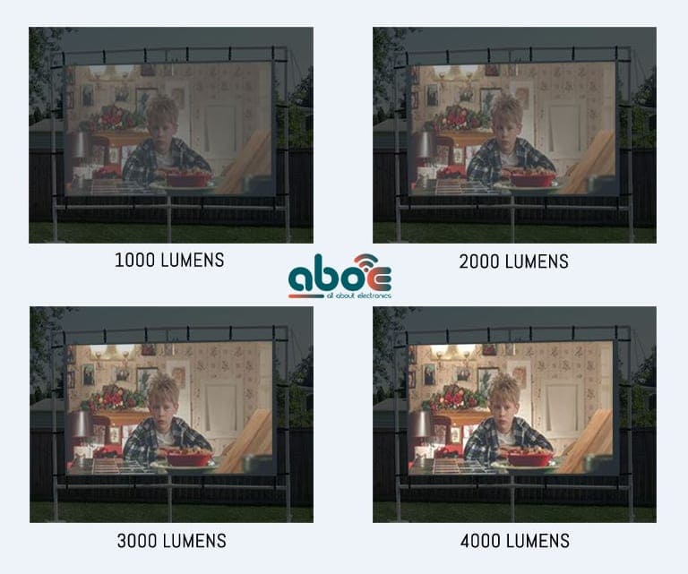
Projector Brightness
For dark areas ~2000 lumens
can be enough.

Slide 4
Projector Brightness
Things that can affect brightness:
Ambient Light
Wall/object color
Wall/object texture
Distance between projector & screen

Slide 5

Color Distortion
The color of your projection will be affected the wall/object color
We can use “overprinting” techniques to resolve our colors

Slide 6
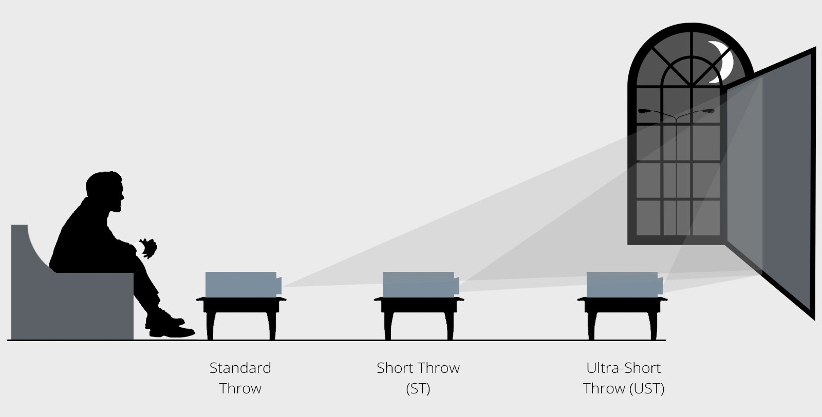
Projection Throw

Slide 7
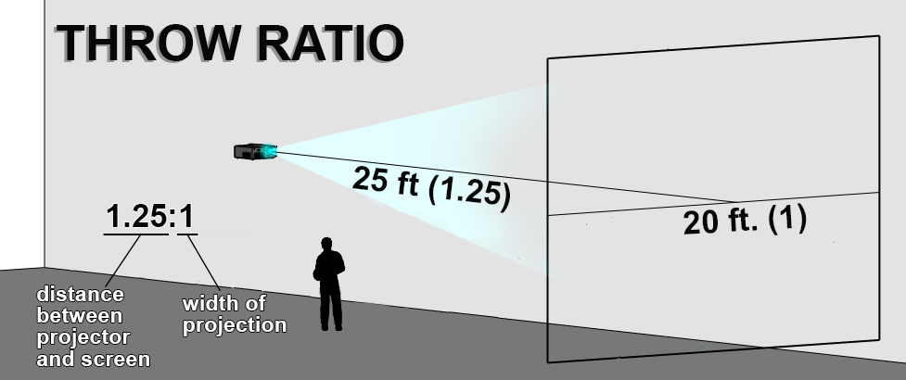
Projection Throw
Example: https://www.projectorcentral.com/Hitachi-CPX2.htm

Slide 8
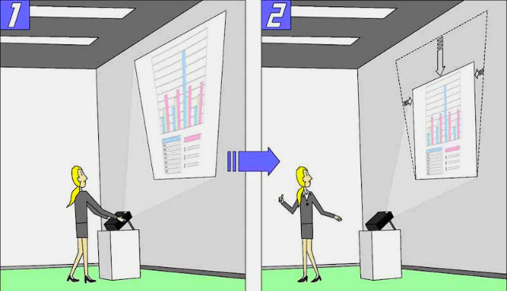
Projection Keystone
Enables you to correct distortion of image caused by the positing of the projector

Slide 9
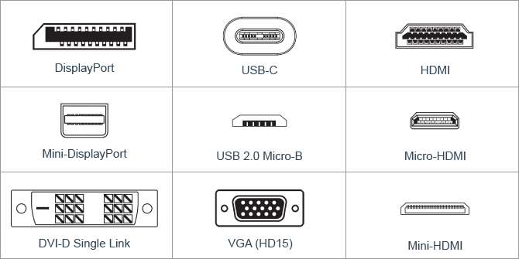
Connections Types

Slide 10
Projecting p5.js
Change your computer to “Extend Mode” (Optional)
Open the “Present” link in p5.js
Select full screen mode in Chrome

